Slide 1
Image filters and morphometric operators Elnaz Fazeli
Training School # 14 BioImage Analysis for Early Career Investigators “Image processing and analysis using Fiji and ilastik”
29.2-3.3, 2020
Centre Broca Nouvelle-Aquitaine, Bordeaux, France
Adopted from
Fabrice P. Cordelières slides Christian Tischer
Paulo de Castro Aguiar
Olivier Burri, Romain Guiet & Arne Seitz

Slide 2
During the lecture
1
How to use linear filtering
Practice with ImageJ Fiji convolve tool
Practice with filters
2
How to use RANK filtering
Practice with ImageJ Fiji RANK filters
3
Practical exercises
Trying uneven background subtraction
Trying noise removal using filters
4
Morphological operators
Trying different morphological operators

Slide 3

What are images
Quick recap of what are images
Images/1-osteoclast.tif
Notes:
Pixel inspector
Tif
Txt
And histogram

Slide 4
During the lecture
1
How to use linear filtering
Practice with ImageJ Fiji convolve tool
Practice with filters

Slide 5
What are images, as Fabrice also said
An image is…
a collection of
pixels
a collection of
frequencies
a collection of
objects
Independent
pixels
Pixels within a
neighbourhood
Connecitviy analysis
&
morphometry
Histogram manipulations
Spatial filtering
Frequential filtering

Slide 6

Images as a collection of pixels
Input image
Histogram manipulations
Spatial
filtering
Pre-processing
Frequential
filtering
Segmentation or connectivity analysis
Alone or as a sequence
Notes:
Ex:
Histogram stretching
Histogram equalization
Gamma
Median filtering
Gaussian filtering
DoG/LoG filtering
Sobel filtering
Filtering in Fourier domain
…

Slide 7
Image filtering
Enhancing image features prior to image analysis.
The purpose is to improve the segmentation accuracy and efficiency, as well as ”beautifying images!”.
It is important to know what you are doing as you are changing the original data by performing any filters.

Slide 8
Linear spatial filters
Linear: every new pixel is a linear combination of the corresponding pixel in the original image and its neighbors
Simple image matrix
Averaging kernel
1 | 0 | 1 | 1 | 0
0 | 0 | 1 | 0 | 1
1 | 1 | 1 | 1 | 1
0 | 1 | 0 | 1 | 0
1 | 0 | 1 | 0 | 1
1/9 | 1/9 | 1/9
1/9 | 1/9 | 1/9
1/9 | 1/9 | 1/9

Slide 9
Linear spatial filters
Simple image matrix
Output matrix
x1/9 | x1/9 | x1/9
x1/9 | x1/9 | x1/9
x1/9 | x1/9 | x1/9
0.67
1 | 0 | 1 | 1 | 0
0 | 0 | 1 | 0 | 1
1 | 1 | 1 | 1 | 1
0 | 1 | 0 | 1 | 0
1 | 0 | 1 | 0 | 1
(1x1/9) + (0x1/9) + (1x1/9) + (0x1/9) + (0x1/9) + (1x1/9) + (1x1/9) + (1x1/9) + (1x1/9) = 6/9 = 0.67

Slide 10
Linear spatial filters
Simple image matrix
Output matrix
x1/9 | x1/9 | x1/9
x1/9 | x1/9 | x1/9
x1/9 | x1/9 | x1/9
0.67 | 0.67
1 | 0 | 1 | 1 | 0
0 | 0 | 1 | 0 | 1
1 | 1 | 1 | 1 | 1
0 | 1 | 0 | 1 | 0
1 | 0 | 1 | 0 | 1
(1x1/9) + (0x1/9) + (1x1/9) + (0x1/9) + (0x1/9) + (1x1/9) + (1x1/9) + (1x1/9) + (1x1/9) = 6/9 = 0.67

Slide 11
Linear spatial filters
Simple image matrix
Output matrix
x1/9 | x1/9 | x1/9
x1/9 | x1/9 | x1/9
x1/9 | x1/9 | x1/9
0.67 | 0.67 | 0.78
1 | 0 | 1 | 1 | 0
0 | 0 | 1 | 0 | 1
1 | 1 | 1 | 1 | 1
0 | 1 | 0 | 1 | 0
1 | 0 | 1 | 0 | 1
(1x1/9) + (1x1/9) + (0x1/9) + (1x1/9) + (0x1/9) + (1x1/9) + (1x1/9) + (1x1/9) + (1x1/9) = 7/9 = 0.78

Slide 12
Linear spatial filters
Simple image matrix
Output matrix
1 | 0 | 1 | 1 | 0
0 | 0 | 1 | 0 | 1
1 | 1 | 1 | 1 | 1
0 | 1 | 0 | 1 | 0
1 | 0 | 1 | 0 | 1
0.67 | 0.67 | 0.78
0.56
x1/9 | x1/9 | x1/9
x1/9 | x1/9 | x1/9
x1/9 | x1/9 | x1/9
(0x1/9) + (0x1/9) + (1x1/9) + (1x1/9) + (1x1/9) + (1x1/9) + (0x1/9) + (1x1/9) + (0x1/9) = 5/9 = 0.56

Slide 13
Linear spatial filters
Simple image matrix
Output matrix
1 | 0 | 1 | 1 | 0
0 | 0 | 1 | 0 | 1
1 | 1 | 1 | 1 | 1
0 | 1 | 0 | 1 | 0
1 | 0 | 1 | 0 | 1
0.67 | 0.67 | 0.78
0.56 | 0.67
x1/9 | x1/9 | x1/9
x1/9 | x1/9 | x1/9
x1/9 | x1/9 | x1/9
(0x1/9) + (1x1/9) + (0x1/9) + (1x1/9) + (1x1/9) + (1x1/9) + (1x1/9) + (0x1/9) + (1x1/9) = 6/9 = 0.67

Slide 14
Linear spatial filters
Simple image matrix
Output matrix
1 | 0 | 1 | 1 | 0
0 | 0 | 1 | 0 | 1
1 | 1 | 1 | 1 | 1
0 | 1 | 0 | 1 | 0
1 | 0 | 1 | 0 | 1
0.67 | 0.67 | 0.78
0.56 | 0.67 | 0.67
x1/9 | x1/9 | x1/9
x1/9 | x1/9 | x1/9
x1/9 | x1/9 | x1/9
(1x1/9) + (0x1/9) + (1x1/9) + (1x1/9) + (1x1/9) + (1x1/9) + (0x1/9) + (1x1/9) + (0x1/9) = 6/9 = 0.67

Slide 15
Linear spatial filters
Simple image matrix
Output matrix
1 | 0 | 1 | 1 | 0
0 | 0 | 1 | 0 | 1
1 | 1 | 1 | 1 | 1
0 | 1 | 0 | 1 | 0
1 | 0 | 1 | 0 | 1
0.67 | 0.67 | 0.78
0.56 | 0.67 | 0.67
0.67
x1/9 | x1/9 | x1/9
x1/9 | x1/9 | x1/9
x1/9 | x1/9 | x1/9
(1x1/9) + (1x1/9) + (1x1/9) + (0x1/9) + (1x1/9) + (0x1/9) + (1x1/9) + (0x1/9) + (1x1/9) = 6/9 = 0.67

Slide 16
Linear spatial filters
Simple image matrix
Output matrix
1 | 0 | 1 | 1 | 0
0 | 0 | 1 | 0 | 1
1 | 1 | 1 | 1 | 1
0 | 1 | 0 | 1 | 0
1 | 0 | 1 | 0 | 1
0.67 | 0.67 | 0.78
0.56 | 0.67 | 0.67
0.67 | 0.67
x1/9 | x1/9 | x1/9
x1/9 | x1/9 | x1/9
x1/9 | x1/9 | x1/9
(1x1/9) + (1x1/9) + (1x1/9) + (1x1/9) + (0x1/9) + (1x1/9) + (0x1/9) + (1x1/9) + (0x1/9) = 6/9 = 0.67

Slide 17
Linear spatial filters
Simple image matrix
Output matrix
1 | 0 | 1 | 1 | 0
0 | 0 | 1 | 0 | 1
1 | 1 | 1 | 1 | 1
0 | 1 | 0 | 1 | 0
1 | 0 | 1 | 0 | 1
0.67 | 0.67 | 0.78
0.56 | 0.67 | 0.67
0.67 | 0.67 | 0.67
x1/9 | x1/9 | x1/9
x1/9 | x1/9 | x1/9
x1/9 | x1/9 | x1/9
(1x1/9) + (1x1/9) + (1x1/9) + (0x1/9) + (1x1/9) + (0x1/9) + (1x1/9) + (0x1/9) + (1x1/9) = 6/9 = 0.67

Slide 18
Linear spatial filters
Simple image matrix
Output matrix
1 | 0 | 1 | 1 | 0
0 | 0 | 1 | 0 | 1
1 | 1 | 1 | 1 | 1
0 | 1 | 0 | 1 | 0
1 | 0 | 1 | 0 | 1
0.67 | 0.67 | 0.78
0.56 | 0.67 | 0.67
0.67 | 0.67 | 0.67

Slide 19
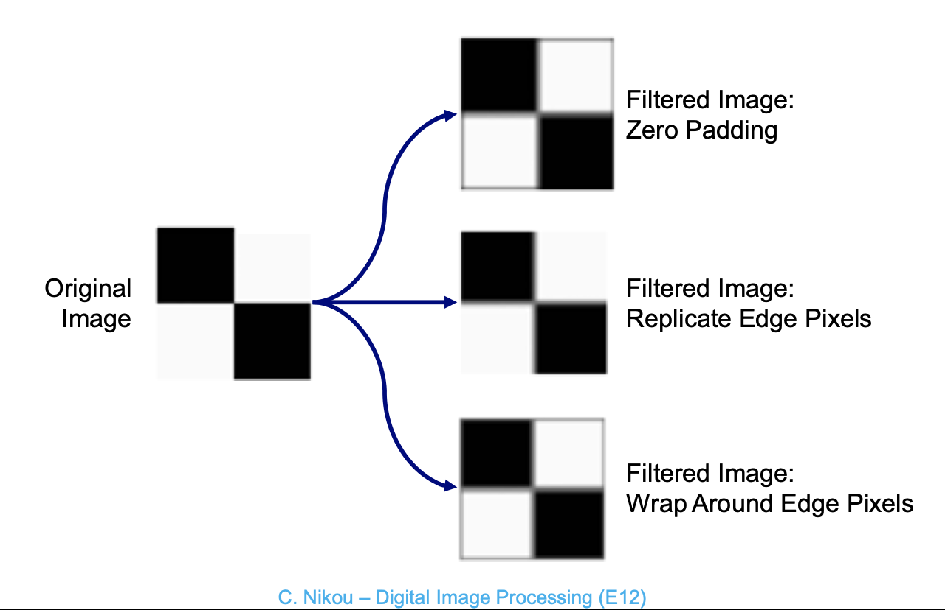
Linear spatial filters-padding
What type of padding does imageJ have?
Images/2-paddingTest.txt

Slide 20
Linear spatial filters-Additional consideration
Filter kernel
In some image processing filters, the operation is only performed using the central pixel and strong neighbors. You will see an example of this in morphological operations when you have 8 or 4 connectivity.

Slide 21
Linear spatial filters- Most frequently used ones
Low-pass filters:
High spatial frequesncies of the image: details or noise
Process -> Smooth
Process -> Filters -> mean… Process -> Filters -> Gaussian blur...
High-pass filters:
Process -> Filters -> Unsharp mask…
Edge detection and enhancement:
Process -> Find edges
Process -> Filters -> variance
Images/3-cat.tif
Notes:
Local variance responds to edges because edges exhibit lots of change in pixel intensity over a small region.
Variance can be defined over a region (kernel) of any size, while most other edge detectors are limited to a 3x3 region.
Local variance is less sensitive to image noise. A single outlying pixel intensity won’t have too much impact. Pre-smoothing is not required.
Local variance does not respond as much to the intensity profile (shape) of the edge. Therefore, the ‘strength’ of a variance defined edge can be normalized by the local intensity of the object.

Slide 22
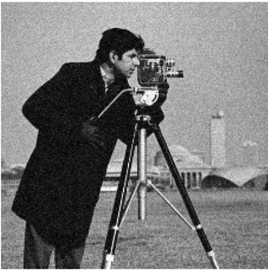
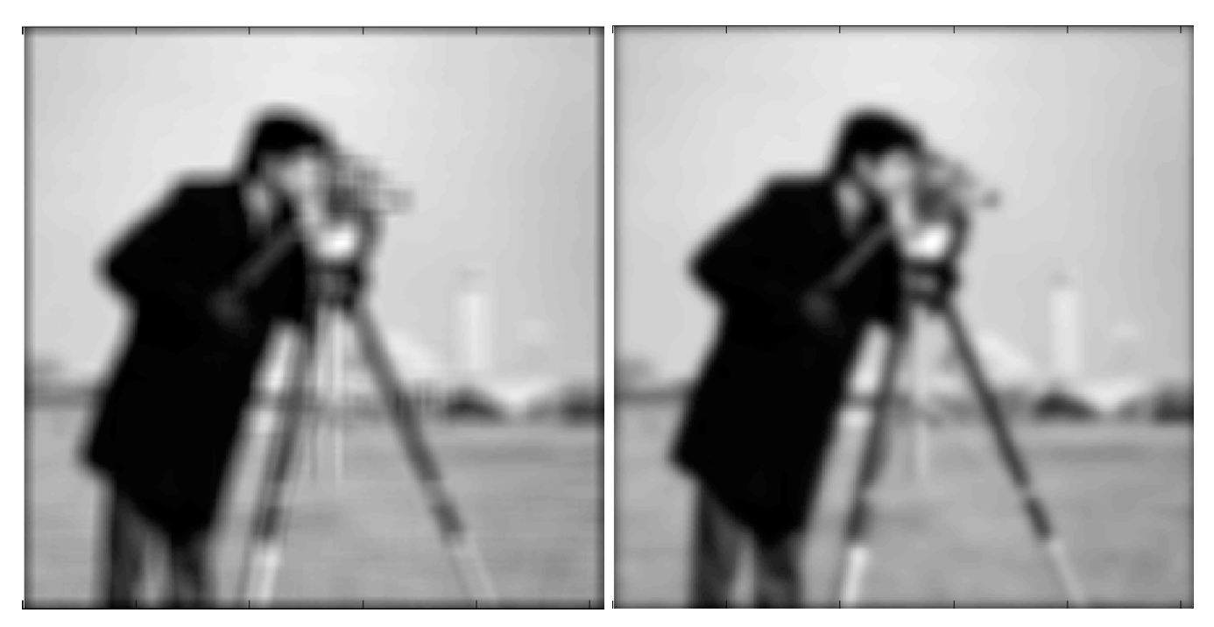
Linear spatial filters- averaging vs gaussian blur
Original
Averaging
Gaussian
Notes:
Averaging good for random noise
It is faster
But you will have high frequency artefacts
ß

Slide 23
Linear spatial filters- Most frequently used ones
1 | 4 | 7 | 4 | 1
4 | 16 | 26 | 16 | 4
7 | 26 | 41 | 26 | 7
4 | 16 | 26 | 16 | 4
1 | 4 | 7 | 4 | 1
-1 | 0 | 1
-2 | 0 | 2
-1 | 0 | 1
-1 | -2 | -1
0 | 0 | 0
1 | 2 | 1
Gaussian
(σ=1)
Sobel
Horizontal
Sobel
Vertical
-1 | -1 | -1
-1 | 12 | -1
-1 | -1 | -1
0 | -1 | 0
-1 | 4 | -1
0 | -1 | 0
-1 | -1 | -1
-1 | 8 | -1
-1 | -1 | -1
Sharpen
Laplacian
4-connected
Laplacian
8-connected
-1 | -1 | -1
0 | 0 | 0
1 | 1 | 1
-1 | 0 | 1
-1 | 0 | 1
-1 | 0 | 1
Try your own filter
Prewitt horizontal
Prewitt vertical
Images/3-cat.tif

Slide 24
Linear spatial filters- The effect of kernel size and shape on final image
1 | 1 | 1
1 | 1 | 1
1 | 1 | 1
1 | 1 | 1 | 1 | 1
1 | 1 | 1 | 1 | 1
1 | 1 | 1 | 1 | 1
1 | 1 | 1 | 1 | 1
1 | 1 | 1 | 1 | 1
3x3
Square
1 | 1 | 1 | 1 | 1
1 | 1 | 1 | 1 | 1
1 | 1 | 1 | 1 | 1
1 | 1 | 1 | 1 | 1
1 | 1 | 1 | 1 | 1
0 | 0 | 1 | 0 | 0
0 | 1 | 1 | 1 | 0
1 | 1 | 1 | 1 | 1
0 | 1 | 1 | 1 | 0
0 | 0 | 1 | 0 | 0
5x5
Diamond
1 | 1 | 1 | 1 | 1 | 1 | 1
1 | 1 | 1 | 1 | 1 | 1 | 1
1 | 1 | 1 | 1 | 1 | 1 | 1
1 | 1 | 1 | 1 | 1 | 1 | 1
1 | 1 | 1 | 1 | 1 | 1 | 1
1 | 1 | 1 | 1 | 1 | 1 | 1
1 | 1 | 1 | 1 | 1 | 1 | 1
0 | 1 | 1 | 1 | 0
1 | 1 | 1 | 1 | 1
1 | 1 | 1 | 1 | 1
1 | 1 | 1 | 1 | 1
0 | 1 | 1 | 1 | 0
7x7
Circle
Images/3-cat.tif

Slide 25
During the lecture
1
How to use linear filtering
Practice with ImageJ Fiji convolve tool
Practice with filters
2
How to use RANK filtering
Practice with ImageJ Fiji RANK filters

Slide 26
Spatial RANK filters
Simple image matrix
Output matrix
5 | 5 | 5
5 | 5 | 5
5 | 5 | 5
0 | 0 | 0
0 | 0 | 0
0 | 0 | 0
1 | 0 | 2 | 1 | 0
0 | 0 | 3 | 0 | 1
1 | 1 | 5 | 1 | 1
0 | 4 | 0 | 1 | 0
1 | 0 | 1 | 0 | 1
1 | 1 | 1
1 | 1 | 1
1 | 1 | 1
Min, Max and Median filters

Slide 27
Spatial RANK filters
A mean filter reduces the intensity of the extreme values but spreads out their influence, while a small median filter is capable of removing them completely with a minimal effect upon the rest of the image.
Minimum and maximum filters can be used for uneven background removal.
Task: Try, minimum, maximum, minimum followed by maximum, gaussian blur, and median filters with different radius
xy_calibrated_16bit__cells_eres_noisy.tif
Good resource: https://petebankhead.gitbooks.io/imagej-intro/content/chapters/filters/filters.html
Notes:
There is more than one way to do image analysis

Slide 28



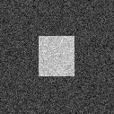

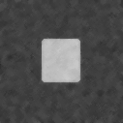
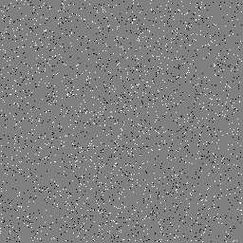
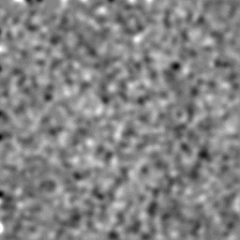

Linear spatial filters- median vs gaussian blur
Original
Gaussian blur (3 pix)
Median (3 pix)
No noise
Higher noise attenuation for Gaussian blur (same radius)
Additive White Gaussian Noise
Gaussian blur
spreads out
outliers
Salt
and pepper

Slide 29
During the lecture
1
How to use linear filtering
Practice with ImageJ Fiji convolve tool
Practice with filters
2
How to use RANK filtering
Practice with ImageJ Fiji RANK filters
3
Practical exercises
Trying uneven background subtraction
Trying noise removal using filters

Slide 30
When do we use filters? Noise removal
Task: Segment the nuclei in the image
Correct background and remove the noise
nuclei-noisy.tif
MAX_nuclei_noisy-2.tif
Notes:
Few things about stacks
Manipulating slices, make a substack and orthogonal view

Slide 31
When do we use filters? Uneven background correction
Task: Segment the spots in the image
Let’s look at the image intensity profile first and try what you have learnt yesterday
Use linear filters to remove the background first
Use RANK filters to remove the background
Good sample preparation and image acquisition is always the best way to start!
Small details (kinetochores, width: 5-6 pixels)
Image from Fabrice
TH.tif
Notes:
Gaussian blur 2, niblack threshold local 50 and 2

Slide 32
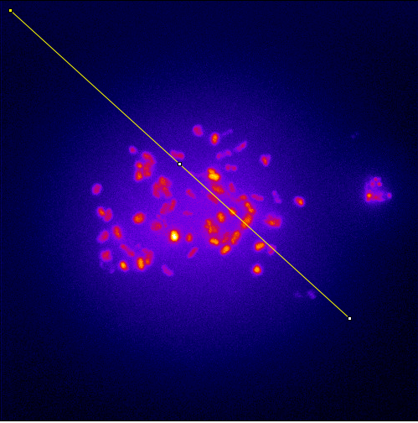
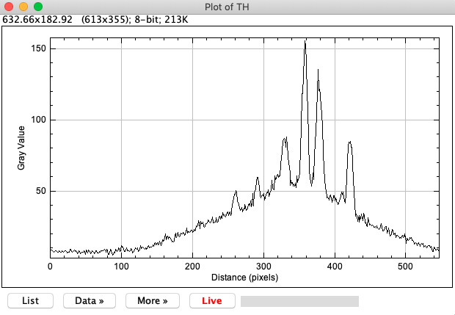
When do we use filters? Uneven background correction
Plot profile
TH.tif

Slide 33
When do we use filters? Uneven background correction
Plot profile
TH.tif

Slide 34
When do we use filters? Uneven background correction
Plot profile
TH.tif

Slide 35

When do we use filters? Uneven background correction
Task: Segment the spots in the image
Use linear filters to remove the background first
1
Duplicate the image
2
Blur the image using one of bluring techniques you learned
3
Subtract the image from the blurred image
4
Plot profile
TH.tif
Notes:
Gaussian blur 15
Or median filter

Slide 36
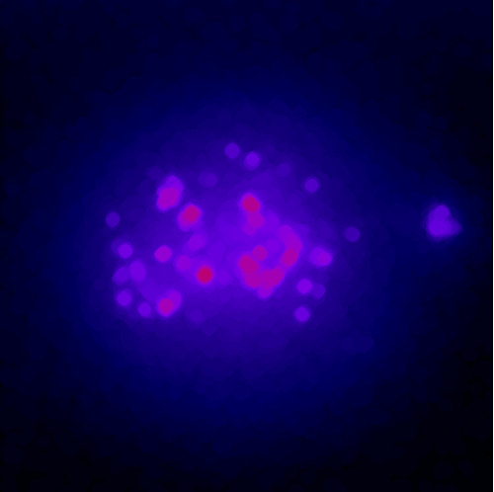
When do we use filters? Uneven background correction
Task: Segment the spots in the image
Use RANK filters to remove the background
1
Duplicate the image
2
Use minimum filter and subsequently maximum filter (top hat filter)
3
Subtract 1 from 2
4
Plot profile
TH.tif
Notes:
Radius 6

Slide 37
When do we use filters? Uneven background correction
Remember these images from Tischi’s lecture?
Let’s try removing the background using the two methods you just learned
uneven-background-test-image.tif
Autophagosomes.tif
Notes:
auto local thresholding is powerful, but it does not remov the background and thus one cannot quantify the intensities. Local background subtraction is better, because it does two things at once: facilitate thresholding but also produces a new image that can be used to quantify the intensities of the small dots. And it is less of a black box algorithm, because one can actually see which background was subtracted. For auto-local-thresholding it is kind of fishing in the dark to find good parameters.

Slide 38
During the lecture
1
How to use linear filtering
Practice with ImageJ Fiji convolve tool
Practice with filters
2
How to use RANK filtering
Practice with ImageJ Fiji RANK filters
3
Practical exercises
Trying uneven background subtraction
Trying noise removal using filters
4
Morphological operators
Trying different morphological operators

Slide 39
Morphological operations
Goal: Improve the binary mask obtained by the segmentation to correctly perform morphological analysis.
Need binary image as input.
Some of the morphological operators (morphomaths):
Dilation
Erosion
Opening
Closing
Watershed
Fill holes
…
Double check Edit -> Options -> Colors…

Slide 40

Morphological operations
Dilation: When the intensity of the center pixel is 1, all the connected pixels are converted to 1.
Gray value equivalent: Maximum
Dilation
https://www.edx.org/course/image-processing-and-analysis-for-life-scientists

Slide 41
Morphological operations
Erosion: When the intensity of the center pixel is 0, all the connected pixels are converted to 0.
Gray value equivalent: Minimum
Erosion

Slide 42
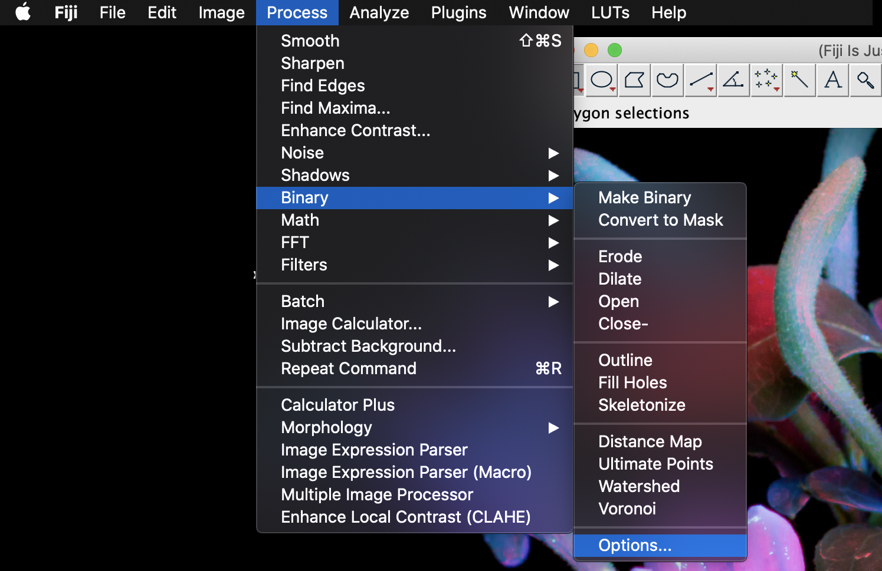
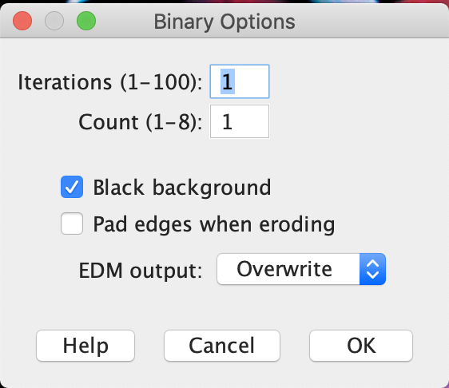
Morphological operations
Opening: Erosion followed by Dilation
Removes small objects and separates components.
Closing: Dilation followed by Erosion
Removes small holes and merges components.
Images/Binary.tif
https://imagej.nih.gov/ij/docs/guide/146-29.html
Notes:
What does iteration and count mean?
Count Specifies the number of adjacent background pixels necessary before a pixel is removed from the edge of an object during erosion and the number of adjacent foreground pixels necessary before a pixel is added to the edge of an object during dilation.
When you do erosion, analyze particles, even if you click on exclude edges you will still have the edge particles. So pay attention to that.

Slide 43
Morphological operations
Task: Using morphological operators, make an outline of the image with the thickness of one pixel
Images/Binary.tif

Slide 44
Morphological operations
Watershed:
Erodes the objects to find the ultimate erode point: objects -> single points
Dilates the points until it reaches the border of the object or the border of another growing object
Good for: homogenous objects with minimal overlap
Images/Binary.tif
Images/Binary2.tif

Slide 45
Morphological operations
Fil holes:
Good step before watershed
It can also fills the space between objects ☹
Task: Combine morphological operators to successfully watershed Binary3.tif
Images/Binary.tif
Images/Binary3.tif

